Slide 1
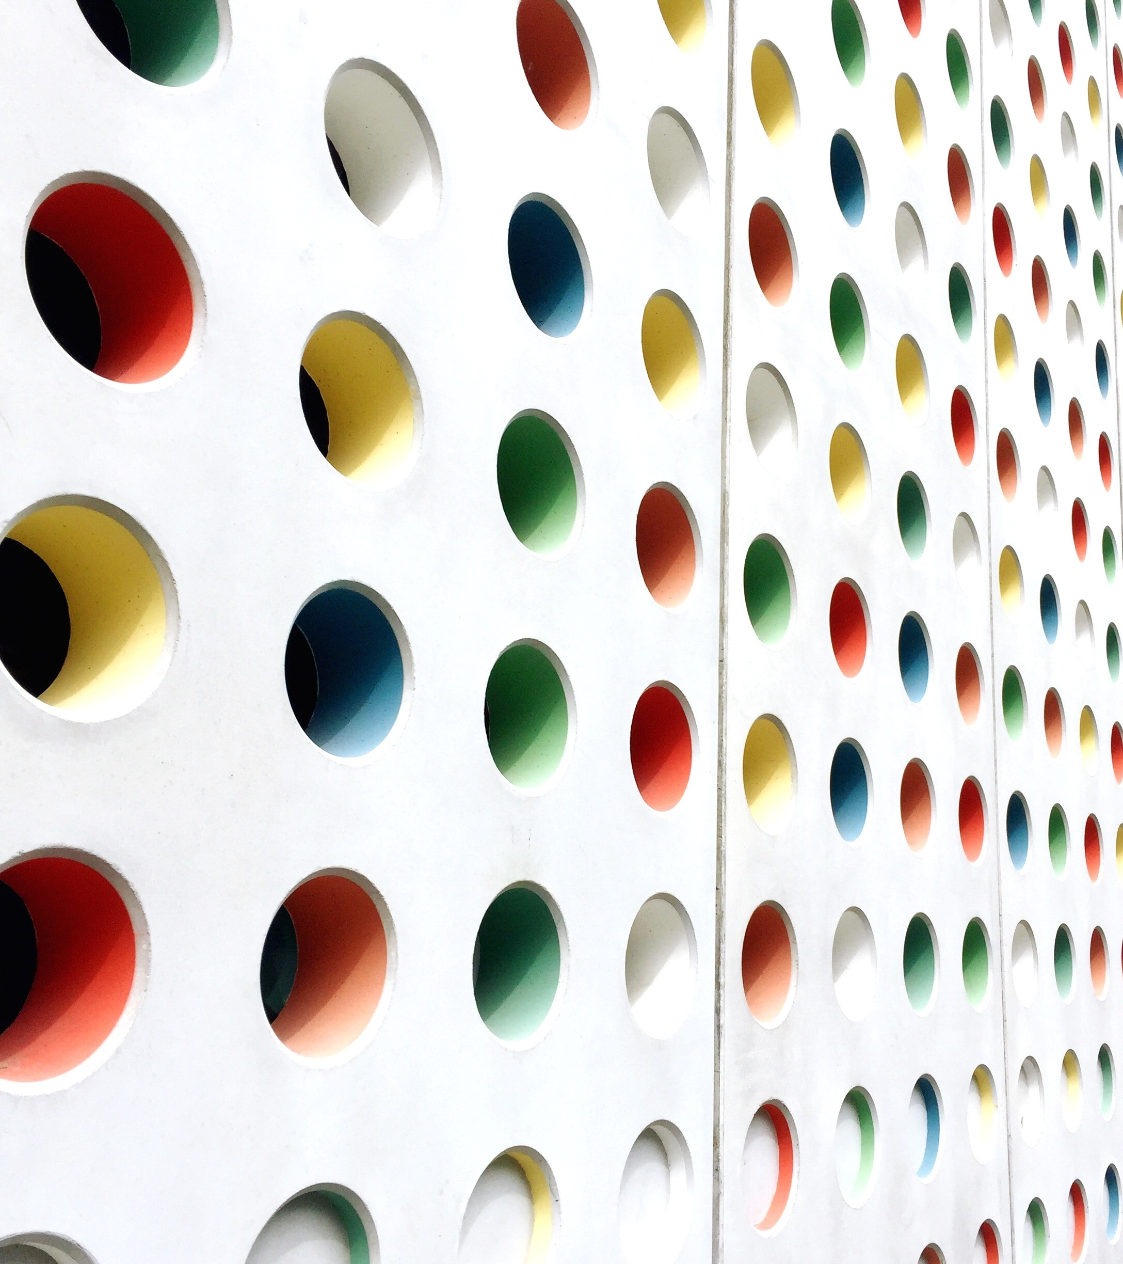

Azure Functions C# Serverless Development from Zero to Hero
Bhushan POOJARY

Slide 2

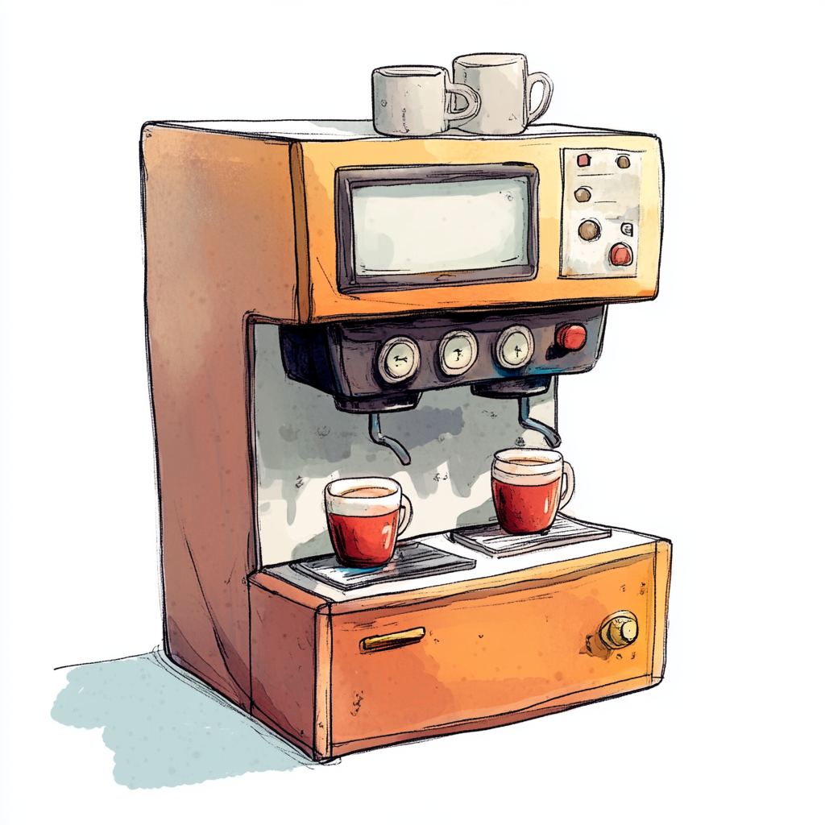
What is Serverless Architecture?
Traditional Architecture: Running a Coffee Shop
Serverless Architecture: Using a Coffee Vending Machine

Slide 3
What is Serverless Architecture?
You rent the shop, hire staff, buy equipment, and keep it running all day.
Even if no customers come in, you're still paying for rent, electricity, and salaries.
You have full control, but also full responsibility.
You place a machine in a public space.
It only works when someone presses a button (an event).
You don’t pay for idle time.
Maintenance, power, and refilling are handled by someone else (the cloud provider).
You just provide the coffee recipe (your code).

Slide 4
Why This Analogy Works:
Concept | Coffee Shop | Vending Machine
Server Management | You manage it all | Provider manages it
Cost | Fixed (rent, staff) | Pay per use
Scaling | Hire more staff | Deploy more machines
Downtime Risk | High if poorly managed | Handled by provider
Deployment Time | Long (setup, licenses) | Instant (just place it)
"With serverless, you're not running the café — you're just giving the recipe and letting the cloud serve coffee whenever someone asks."

Slide 5



What is Serverless Architecture?
Serverless architecture is a cloud computing model where developers write and deploy code without worrying
about the underlying infrastructure — like servers, provisioning, scaling, or maintenance.
⚠️ “Serverless” doesn't mean there are no servers. It means you don’t have to manage them.
Cloud providers like Azure, AWS, or GCP handle all of that for you.

Slide 6


Real-world Use Case
Let’s say you want to process uploaded images:
In a serverless setup, an Azure Function is triggered every time a new image is uploaded to blob storage.
It processes the image, resizes it, and saves it — without you managing any virtual machines.

Slide 7
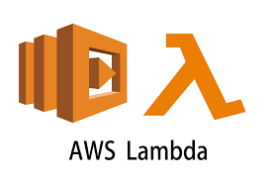
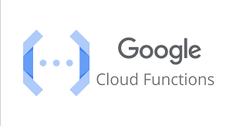
Common Serverless Platforms

Slide 8
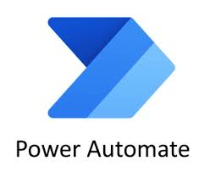

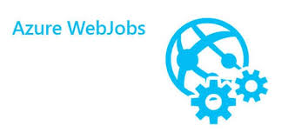
Azure serverless apps
Design First
Code First

Slide 9
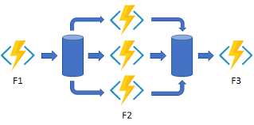
Azure functions and Azure Durable Functions
Azure functions
Azure Durable functions

